Slide 1
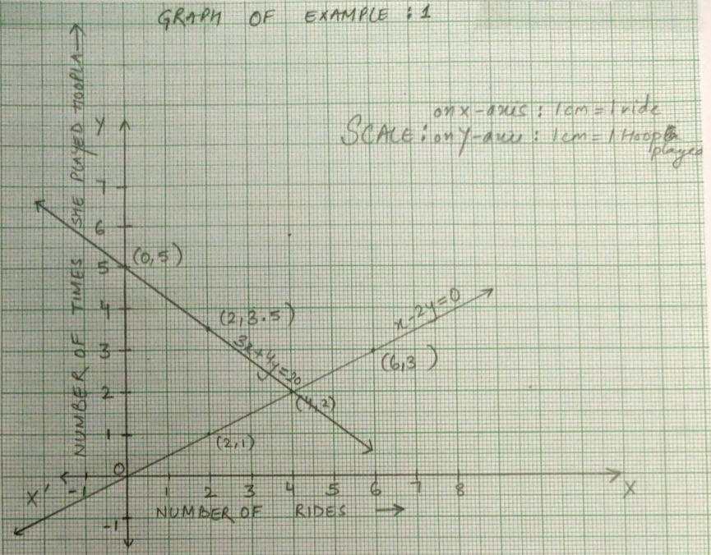
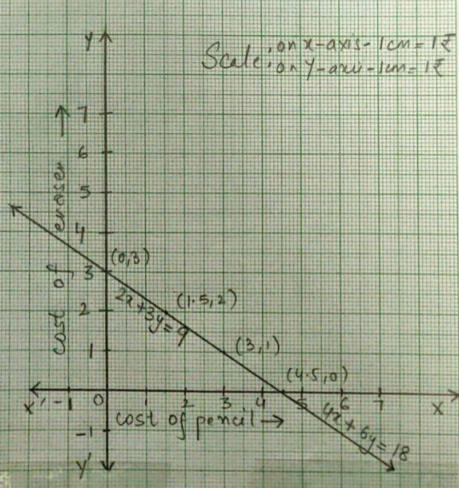
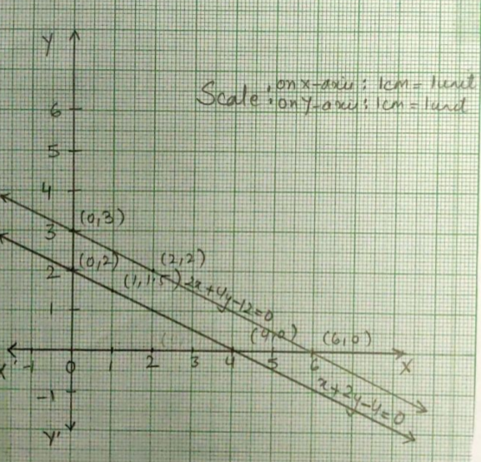
Dear students, so far we have learnt about algebraic and geometrical representation of a pair of linear equations in two variables.
We have seen that when we represent a pair of linear equations or a system of equations graphically , the lines either intersect or coincide or are parallel to each other as shown below:
But, drawing graphs is not the only method of determining the graphical representation of a given system of linear equations.

Slide 2
The system of equations represented by the given graph is
x- 2y=0
3x+4y=20
If the above system of linear equations is compared to the
general system of linear equations given by
$$a_{1}x+ b_{1}y+c_{1}=0$$
$$a_{2}x+ b_{2}y+c_{2}=0$$
then, $a_{1}$=1, $b_{1}$= -2 , $c_{1}$=0
and $a_{2}$=3, $b_{2}$= 4 , $c_{2}$=-20
Note that , here, $\frac{a_{1}}{a_{2}}$$≠$$\frac{b_{1}}{b_{2}}$
Thus, graph for system of equations with $\frac{a_{1}}{a_{2}}$$≠$$\frac{b_{1}}{b_{2}}$would represent intersecting lines.

Slide 3
The system of equations represented by the given graph is
2x+3y=9
4x+6y=18
Comparing the above system of equations with the general
system of equations given by:
$${ a}_{1}x+ b_{1}y+c_{1}=0$$
$a_{2}x+ b_{2}y+c_{2}=0$
we get that
$a_{1}$=2, $b_{1}$= 3 , $c_{1}$=-9 and $a_{2}$=4, $b_{2}$= 6 , $c_{2}$=-18
Here, $\frac{a_{1}}{a_{2}}$ = $\frac{b_{1}}{b_{2}}$$=$$\frac{c_{1}}{c_{2}}$
So, we see that if for a system of equations, $\frac{a_{1}}{a_{2}}$ = $\frac{b_{1}}{b_{2}}$$=$$\frac{c_{1}}{c_{2}}$ is true, then the graph for the same represents coinciding lines.

Slide 4
The system of equations represented by the given graph is
x+2y-4=0
2x+4y-12=0
Again, let us compare the above system of equations with the
general system of equations given by:
$${ a}_{1}x+ b_{1}y+c_{1}=0$$
$a_{2}x+ b_{2}y+c_{2}=0$
Here, $a_{1}$=1, $b_{1}$= 2 , $c_{1}$= -4 and $a_{2}$=2, $b_{2}$= 4 , $c_{2}$= -12
We note that for the above system of equations,
$\frac{a_{1}}{a_{2}}$ = $\frac{b_{1}}{b_{2}}$$≠$$\frac{c_{1}}{c_{2}}$
So, for a system of equations if we have $\frac{a_{1}}{a_{2}}$ = $\frac{b_{1}}{b_{2}}$$≠$$\frac{c_{1}}{c_{2}}$, then its graphical representation would be parallel lines.

Slide 5
Recall that every point which lies on the straight line is said to be its solution.
For example, consider the following equation again
x – 2 y =0
The solution set for the above equation is given by:
Which means that the points (2,1); (4,2)and (6,3)lie on the line represented by the given equation.
x | 2 | 4 | 6
y | 1 | 2 | 3

Slide 6
CONSISTENCY AND INCONSISTENCY OF A SYSTEM OF LINEAR EQUATIONS IN TWO VARIABLES
We have already seen graphical representation of a system of equations.
If the lines intersect, they meet each other at exactly one point
i.e. they share a common solution.
In the graph we see that the lines represented by the
equations
x- 2y=0
3x+4y=20
meet at the point (4,2).
Therefore, (4,2) is their unique or common solution.

Slide 7
Consider the following system of equations
Now just look at the graph for the above system of equations.
As it can be seen that the graph represents coinciding lines.
This is because of the fact that the equations in the given system
are dependent.
By dependent equations we mean that one equation can be derived from the other.
Here it is evident that the second equation 4x+6y=18 can be derived from the first equation 2x+3y=9 by multiplying it by 2.
Therefore, both the equations will have a common solution set.
Graphically, we can see that these equations meet each other at infinitely many points.
Thus , the system has infinitely many solutions.
2x+3y=9
4x+6y=18

Slide 8
Note: Make a note of the fact that a system of equations is said to be consistent if it has atleast one common solution.
Thus, a system of equations is said to be consistent if it has a unique solution or infinitely many solutions.
And graphical representation for a consistent system is either intersecting lines or coinciding lines.

Slide 9
Finally let us consider the system of equations:
x+2y-4=0
2x+4y-12=0
Clearly, the graphical representation of the above system is
parallel lines, i.e. these lines do not meet each other at any
point.
In other words, these equations do not have any common
solution.
Thus, they represent a system with no solution.
The system of equations with no solution is said to be inconsistent.
Now check out this video to recapitulate whatever we have learnt so far.

Slide 10
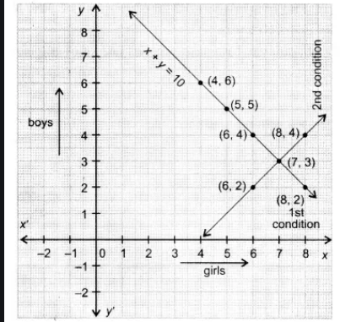
Let us now begin with the exercise questions.
Ex- 3.2
Q1.(a) 10 students of Class X took part in a Mathematics quiz. If the number of girls is 4 more than the number of boys, find the number of boys and girls who took part in the quiz.
Solution: Let the number of girls participating in the quiz =x
and let the number of boys participating in the quiz =y
According to the question,
x + y =10
and
x = 4 + y
The graph for the above system of equation looks like
From the graph, we get that the common solution is (7,3)
i.e. No. of girls= 7 and
No. of boys =3
x | 6 | 7 | 4
y | 4 | 3 | 6
x | 7 | 8 | 6
y | 3 | 4 | 2

Slide 11
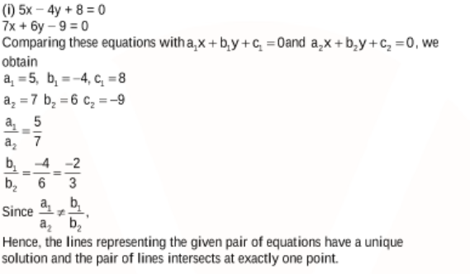
Now , do the second part of the question 1 in your notebook.
Let us now begin with the second question:
Q2.On comparing the ratios, $\frac{a_{1}}{a_{2}}$ , $\frac{b_{1}}{b_{2}}$$and$$\frac{c_{1}}{c_{2}}$find out whether the lines representing the following pairs of linear
equations intersect at a point, are parallel or coincident:
Now , complete the rest of the parts of question 2 in your notebook.

Slide 12
Let us now discuss Q3 from the exercise.
Q3. On comparing the ratios, $\frac{a_{1}}{a_{2}}$ , $\frac{b_{1}}{b_{2}}$$and$$\frac{c_{1}}{c_{2}}$, find out whether the following pair of linear equations are consistent, or inconsistent.
Solution : (i) 3x + 2y = 5 ; 2x – 3y = 7
Here, $a_{1}$=3, $b_{1}$= 2 , $c_{1}$= -5 and $a_{2}$=2, $b_{2}$= - 3 , $c_{2}$=- 7
Then, $\frac{a_{1}}{a_{2}}$ = $\frac{3}{2}$ and $\frac{b_{1}}{b_{2}}$ = $\frac{2}{−3}$
Clearly, $\frac{a_{1}}{a_{2}}$$≠$$\frac{b_{1}}{b_{2}}$
Thus, the above pair of equations are consistent with a unique solution.
Note: Complete the rest of the parts of question 3, question 4 and question 5 in your notebook.

Slide 13
Q 6. Given the linear equation 2x + 3y – 8 = 0, write another linear equation in two variables such that the geometrical representation of the pair so formed is:
intersecting lines
Solution: (i) We know that for a system of equations to represent intersecting lines, the condition , $\frac{a_{1}}{a_{2}}$$≠$$\frac{b_{1}}{b_{2}}$ must be satisfied by the set of equations.
We are already given one of the equations. We should frame another equation in such a manner that the given condition is satisfied.
For example, if we choose the other equation to be 3x+2y-9=0, the condition $\frac{a_{1}}{a_{2}}$$≠$$\frac{b_{1}}{b_{2}}$
gets satisfied.
So we can say that the equation 3x+2y-9=0 along with 2x + 3y – 8 = 0 represents intersecting lines.
Similarly , 2x-3y-8=0 along with 2x + 3y – 8 = 0 also represents intersecting lines.
Thus, we can have infinitely many such equations which along with the given equation satisfy the condition $\frac{a_{1}}{a_{2}}$$≠$$\frac{b_{1}}{b_{2}}$ and represent intersecting lines.
Now, complete the next two parts of the question in your Mathematics notebook.

Slide 14
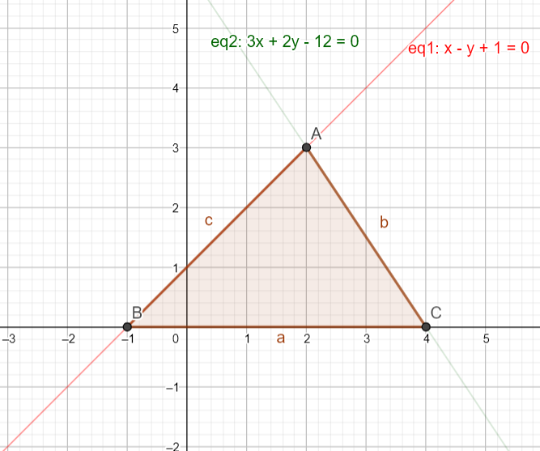
Q7. Draw the graphs of the equations x – y + 1 = 0 and 3x + 2y – 12 = 0. Determine the coordinates of the vertices of the triangle formed by these lines and the x-axis, and shade the triangular region.
Solution: For equation x – y + 1 = 0, we have following points which lie on the line
For equation 3x + 2y – 12 = 0, we have following points which lie on the line
The graph for the above equations is given by:
Clearly, the solution for the equations is
x=2, y=3.
The vertices of the required
triangle are given by (2,3); (- 1,0) and (4,0).
x | 0 | 2 | 3
y | 1 | 3 | 4
x | 2 | 4 | 0
y | 3 | 0 | 6

Slide 15
PRACTICE TIME
Questions for practice ( From assignment )
1. Solve graphically: 2x + y = 6; 2x – y + 2 = 0
Find the ratio of the area of two triangles formed by the lines representing these equations with the x-axis and the lines with the line x=0.
2. Draw the graphs of the given equation : 2x+y=2; 2x+y=6. Find the coordinates of the trapezium formed by these lines. Also find its area.
3. Draw the graphs of the equations: x + 3y = 6 ; 2x – 3y = 12 and hence find a if
3x + 2y = 3+ a . Find the area of the triangle formed by these lines with Y-axis
4. Show graphically that the pair of linear equations 2x – 2y -2 = 0; 4x -4y -10 = 0 is inconsistent.

